Slide 1
IOT Based Smart Restaurant Menu Using Beaglebone Black Wireless Task Interfacing NodeMCU with BB-WI
Submitted to:
Prof. Mike Aleshams
Submitted by:
Ramandeep Kaur
Group 3

Slide 2
Project Description (Smart Restaurant food ordering menu using BB-WI)
These days, due to Covid-19 ,restaurants want a safe environment for their customer. For the least & safe interaction between customer and owner smart restaurant ordering menu comes in picture. For maintaining a safe distance with customer, instead of using paper-based menu cards, Restaurants are now installing touch screen displays on tables, so the customers can directly select the food items from the screen and order the food easily.

Slide 3
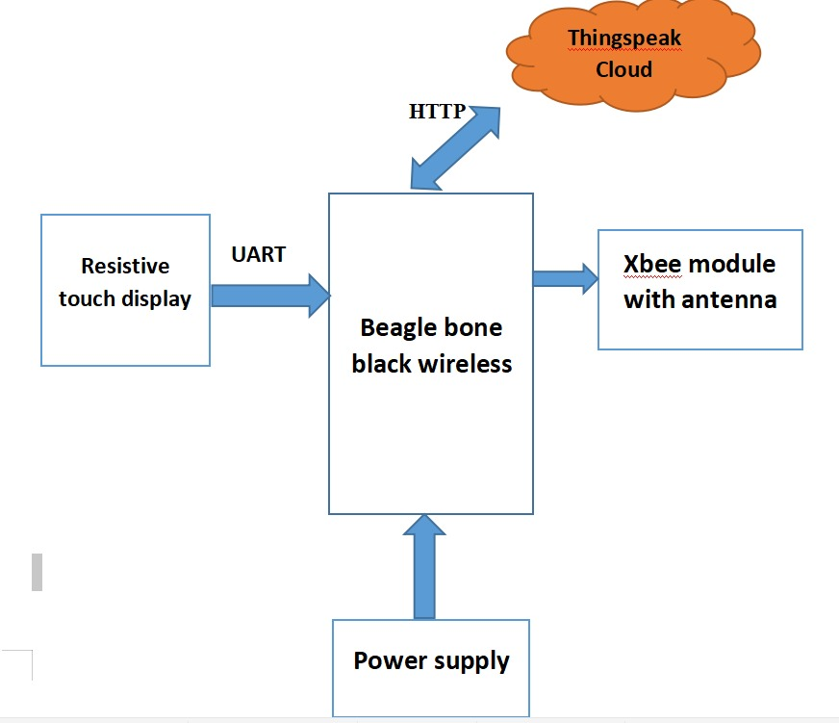
Block Diagram(Tranmitter Side)

Slide 4
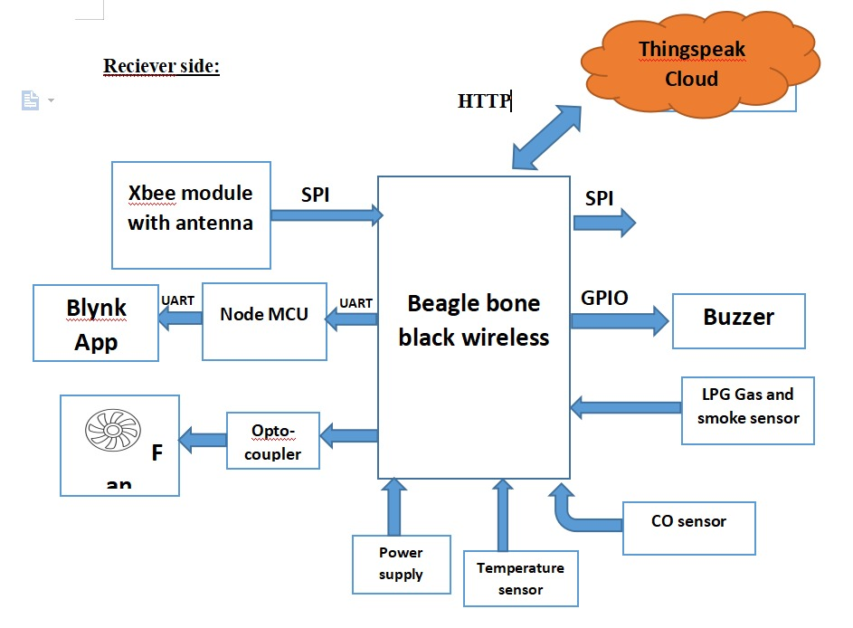
Block Diagram(Receiver Side)

Slide 5
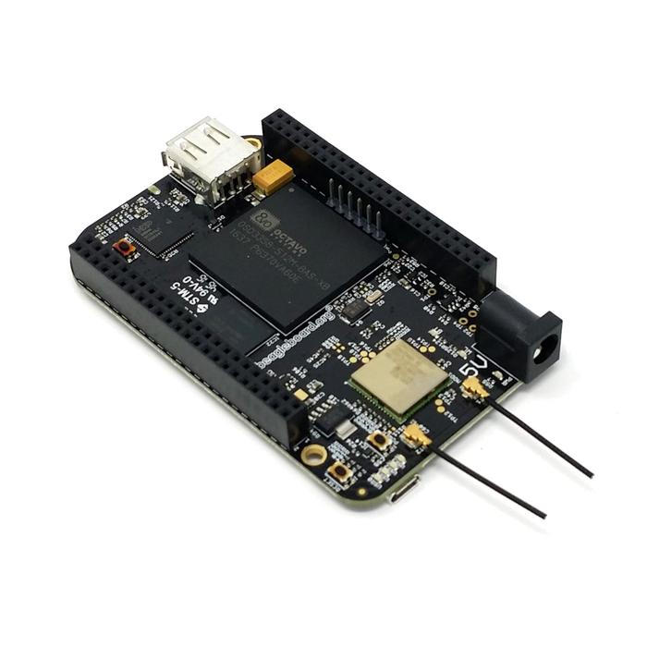
Beaglebone Black Wireless
Based on the extremely successful open-source Beaglebone Black hardware design, Beaglebone Black Wireless is a high-expansion, maker-focused, community-supported open hardware computer created by the BeagleBoard.org Foundation.

Slide 6
Features of BB-WI
Utilizes Octavo Systems OSD3358 with integrated 1GHz TI AM335x processor, 512MB DDR3 RAM, power management and over 100 supporting passive devices in a single system-in-package device
Open hardware created in CadSoft EAGLE utilizing readily available components for easy and affordable customization

Slide 7
Specifications of BB-WI
512MB DDR3 RAM
4GB 8-bit eMMC on-board flash storage
3D graphics accelerator
NEON floating-point accelerator
2x PRU 32-bit microcontroller

Slide 8
Software compatibility of BB-WI
Debian pre-configured with Cloud9 IDE on Node.js with BoneScript library
Third-party support of Android, Ubuntu and many more upon open source Linux kernel
Non-operating-system-based peripheral support vi TI StarterWare library

Slide 9
User input/output
Reset button
Boot button
Power button
4 user configurable LEDs; WiFi and BT enable LEDs; power LED

Slide 10
Expansion header
65 digital I/O with general purpose I/O, SPI, I2C, PWM, CAN, UART, SD, quadrature encoders and more
7 analog inputs
Power in/out

Slide 11
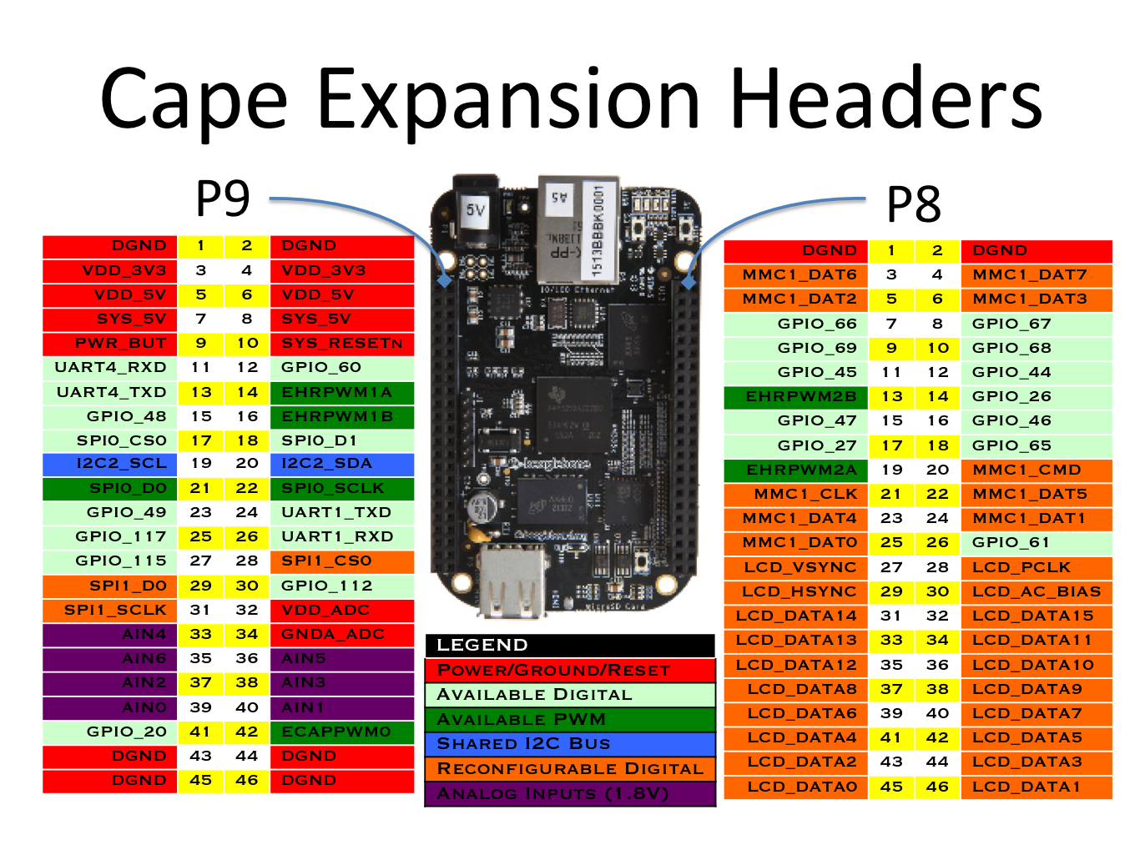
Pin Diagram of Beaglebone Black Wireless

Slide 12
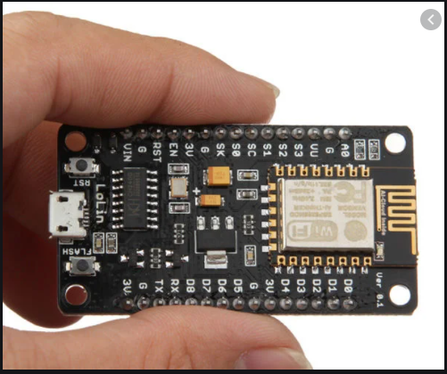
NodeMCU ESP8266
The NodeMCU ESP8266 development board comes with the ESP-12E module containing ESP8266 chip having Tensilica Xtensa 32-bit LX106 RISC microprocessor. This microprocessor supports RTOS and operates at 80MHz to 160 MHz adjustable clock frequency

Slide 13
Peripherals and I/O
The ESP8266 NodeMCU has total 17 GPIO pins broken out to the pin headers on both sides of the development board. These pins can be assigned to all sorts of peripheral duties, including:
ADC channel – A 10-bit ADC channel.
UART interface – UART interface is used to load code serially.
PWM outputs – PWM pins for dimming LEDs or controlling motors.
SPI, I2C & I2S interface – SPI and I2C interface to hook up all sorts of sensors and peripherals.
I2S interface – I2S interface if you want to add sound to your project.

Slide 14
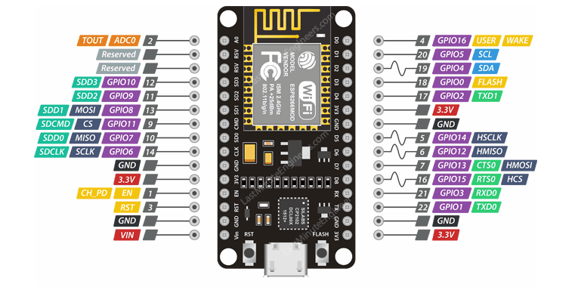
Pin Diagram of NodeMCU ESP8266

Slide 15
NodeMCU8266
Power pins: There are four power pins,one is VIN and three 3.3v pins.The VIN pin can be used to directly supply the ESP8266 and its peripherals,if you have 5V voltage source.The 3.3V pins are the output of an on-board voltage regulator.

Slide 16
NodeMCU8266
GND: This is a ground pin of ESP8266 NodeMCU development board.
I2C pins: These are used to hook up all sorts of I2C sensors and peripherals in your project. Both I2C Master and I2C Slave are supported.

Slide 17
NodeMCU8266
GPIO pins: ESP8266 NodeMCU has 17 GPIO pins which can be assigned to various functions such as I2C, I2S, UART, PWM, IR Remote Control, LED Light and Button programmatically. Each digital enabled GPIO can be configured to internal pull-up or pull-down, or set to high impedance. When configured as an input, it can also be set to edge-trigger or level-trigger to generate CPU interrupts.

Slide 18
NodeMCU8266
ADC channel: The NodeMCU is embedded with a 10-bit precision SAR ADC. The two functions can be implemented using ADC viz. Testing power supply voltage of VDD3P3 pin and testing input voltage of TOUT pin.

Slide 19
NodeMCU8266
UART pins: ESP8266 NodeMCU has 2 UART interfaces, UART0 and UART1, which provide asynchronous communication and can communicate at up to 4.5 Mbps. UART0 (TXD0, RXD0, RST0 & CTS0 pins) can be used for communication.

Slide 20
NodeMCU8266
SPI pins: ESP8266 features two SPIs (SPI and HSPI) in slave and master modes. These SPIs also support the following general-purpose SPI features:
4 timing modes of the SPI format transfer
Up to 80 MHz and the divided clocks of 80 MHz
Up to 64-Byte FIFO

Slide 21
NodeMCU8266
SDIO pins: ESP8266 features Secure Digital Input/Output Interface (SDIO) which is used to directly interface SD cards. 4-bit 25 MHz SDIO v1.1 and 4-bit 50 MHz SDIO v2.0 are supported.

Slide 22
NodeMCU8266
PWM pins: The board has 4 channels of Pulse Width Modulation (PWM). The PWM output can be implemented programmatically and used for driving digital motors and LEDs.

Slide 23
NodeMCU8266
Control pins:Thesepins are used to control ESP8266. These pins include Chip Enable pin (EN), Reset pin (RST) and WAKE pin.
EN pin – The ESP8266 chip is enabled when EN pin is pulled HIGH. When pulled LOW the chip works at minimum power.
RST pin – RST pin is used to reset the ESP8266 chip.
WAKE pin – Wake pin is used to wake the chip from deep-sleep.

Slide 24
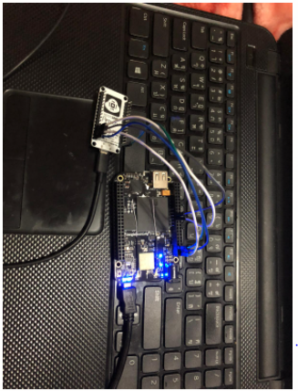
Interfacing NodeMCU8266 with BB-WI

Slide 25
SSH to Beaglebone Black Wireless
Type this command in terminal and make ssh connection to BB-WI
ssh Debian@192.168.7.2
After this, put default password “temppwd”

Slide 26
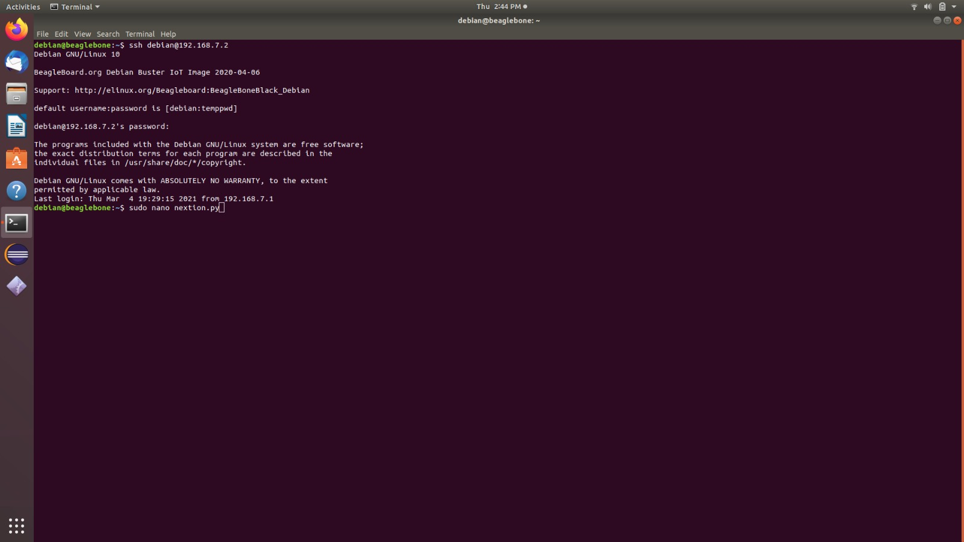
SSH to Beaglebone Black Wireless

Slide 27
Beaglebone Black Wireless | NodeMCU8266
P9_3(VDD_3V3) | 3.3V
P9_1(DGND) | GND
P9_26(UART1_RxD) | Tx
P9_24(UART1_TXD) | Rx

Slide 28
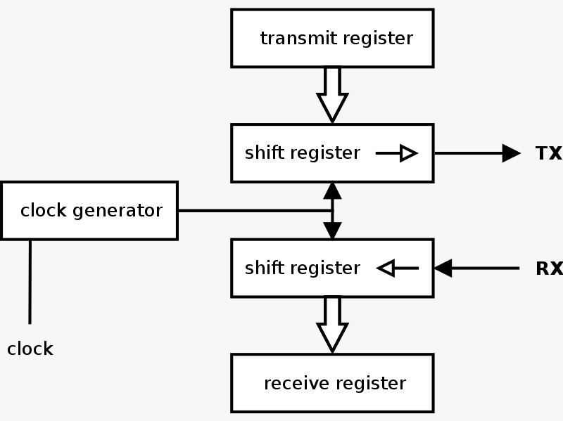
Interfacing communication protocol:UART
A universal asynchronous receiver-transmitter (UART) is a computer hardware device for asynchronous serial communication in which the data format and transmission speeds are configurable.
It sends data bits one by one, from the least significant to the most significant, framed by start and stop bits so that precise timing is handled by the communication channel.

Slide 29
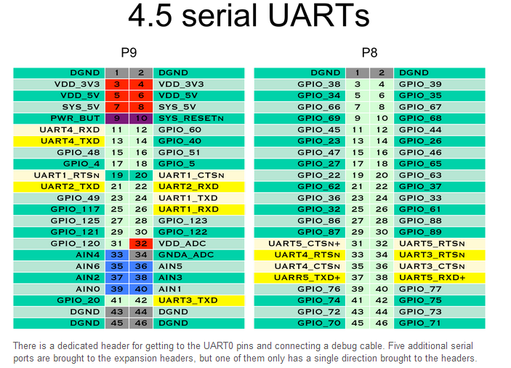
Interfacing communication protocol:UART
Beaglebone Black Wireless have 4.5 serial UARTs.
For interfacing with touch screen display, we can use either of UART1, UART2, UART4.
We cannot use UART3 for interfacing with touch screen display, because UART3 has only transmit pin.

Slide 30
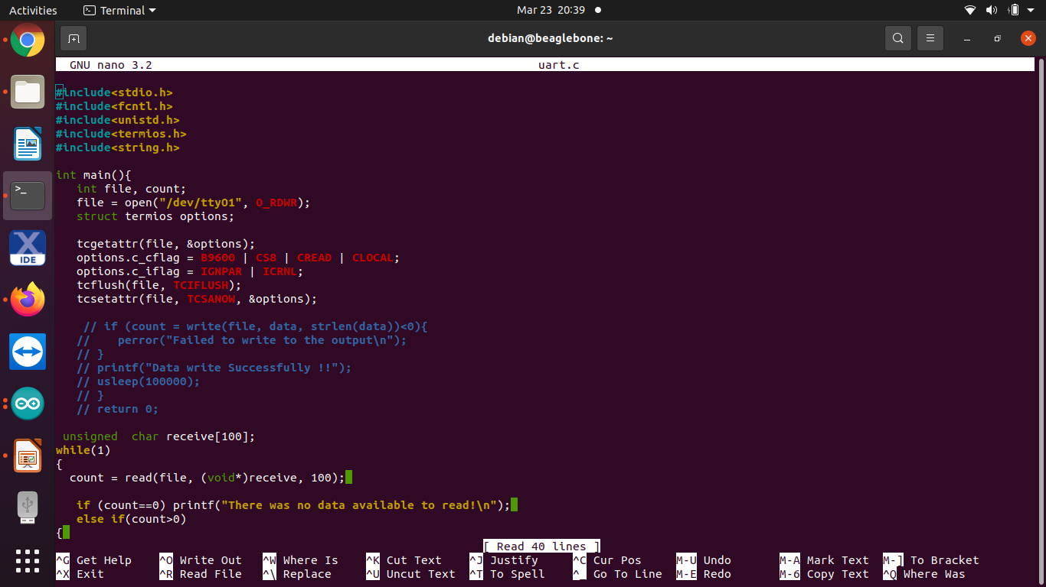
C code for Interfacing NodeMCU8266

Slide 31
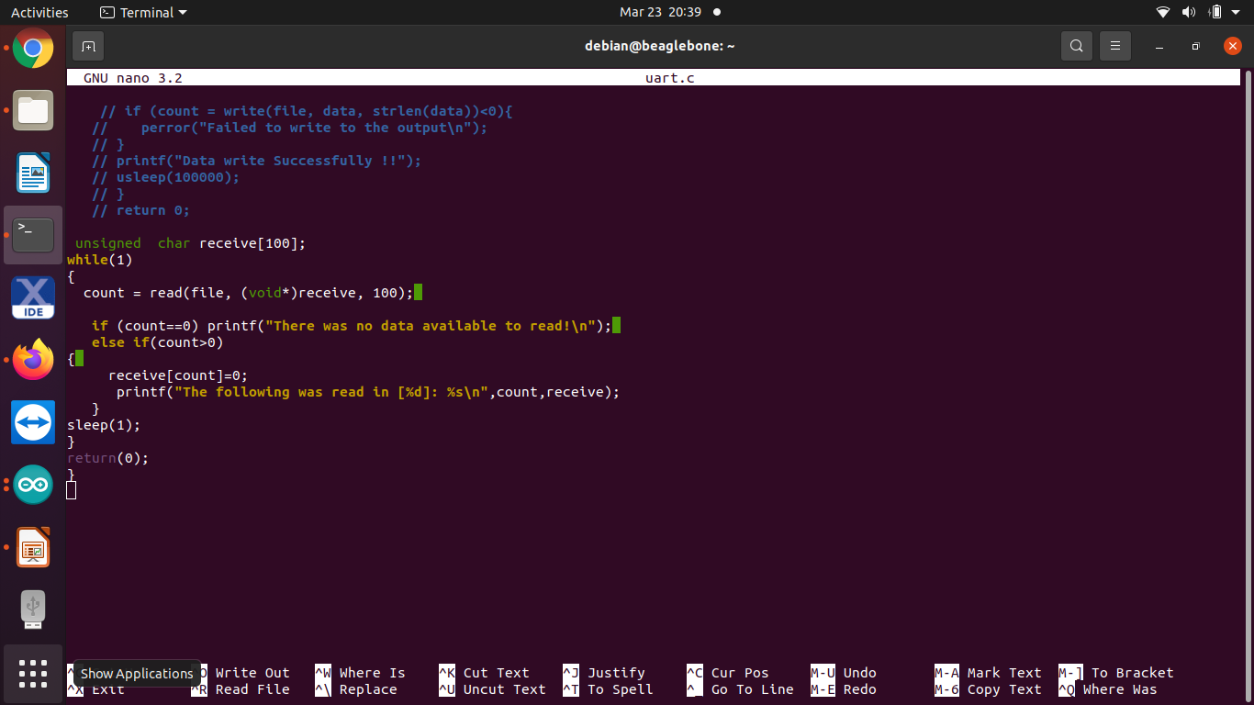
C code for Interfacing NodeMCU8266

Slide 32
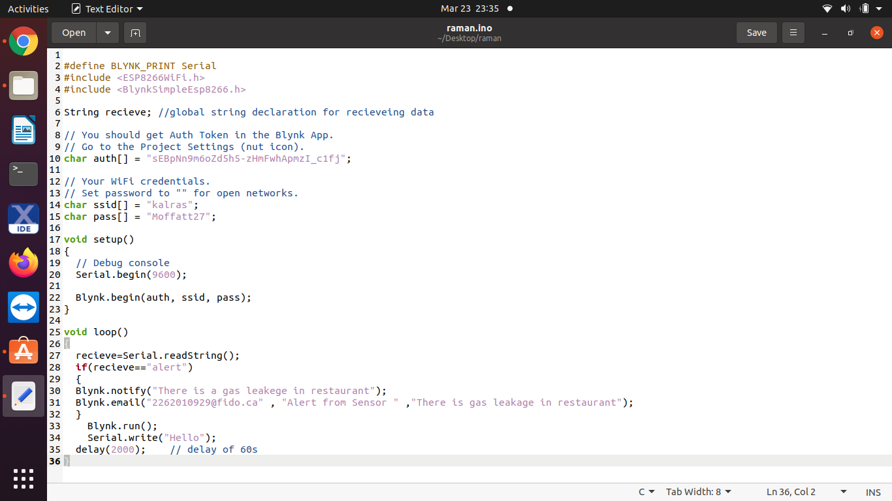
Code for NodeMCU8266

Slide 33
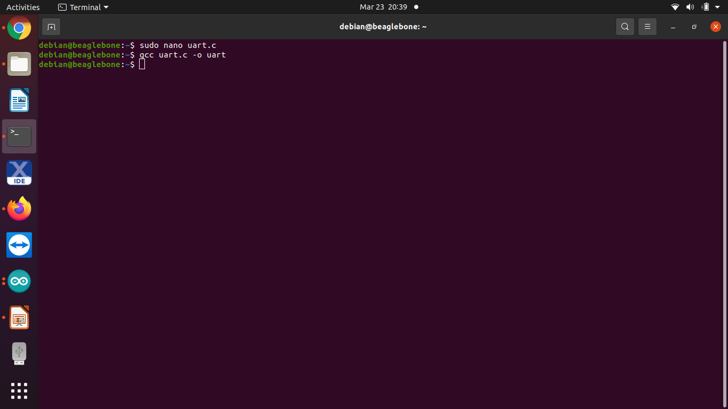
Compile the Program

Slide 34
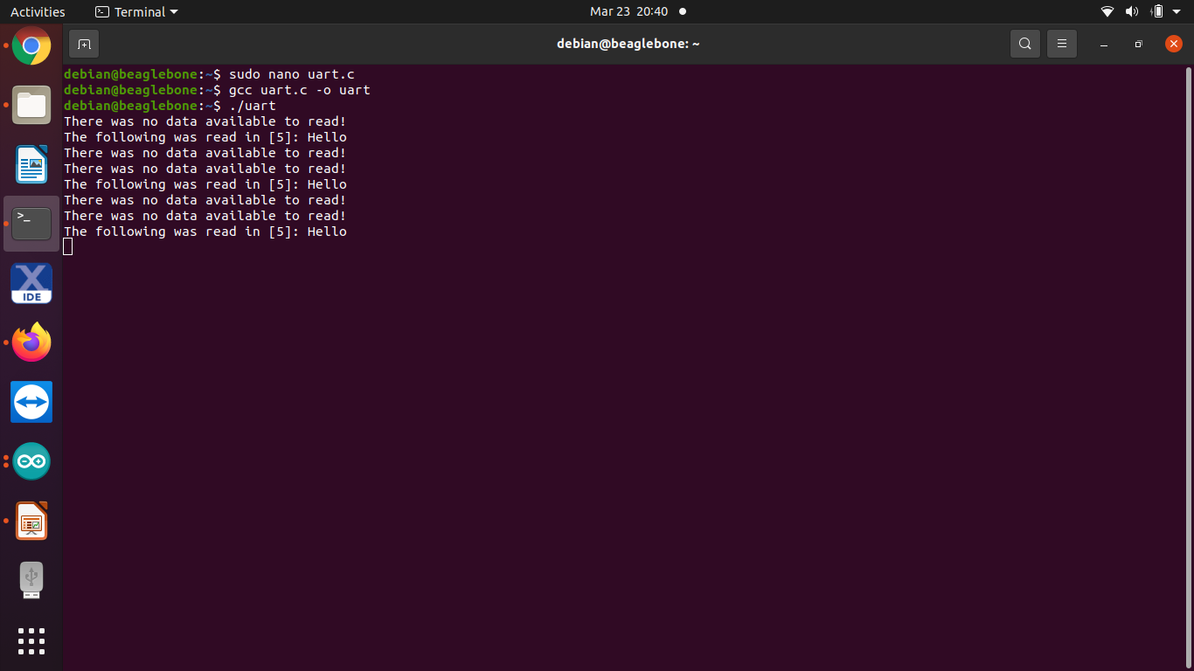
Output

Slide 35
C code
#include<stdio.h>
This header defines three variable types, several macros and various functions for performing input and output.
#include<fcntl.h>
This header shall define the following requests and arguments for use by the function fcntl() and open().
#include<unistd.h>
This header defines miscellaneous symbolic constants , types and declares miscellaneous functions.

Slide 36
C code
#include<termios.h>
This header contains the definitions used by the terminal Input Output interfaces.
#include<string.h>
This header defines one variable type, one macro and various functions for manipulating arrays of characters.
file = open("/dev/ttyO1", O_RDWR);
This line enabling the UART1.

Slide 37
C code
tcgetattr(file, &options);
tcgetattr() function shall get the parameters associated with the terminal referred to by flides and store them in the termios structure referenced by termios_p.
tcflush(file, TCIFLUSH);
The tcflush function is used to clear the input and output queue associated with terminal file filedes.

Slide 38
References:
NodeMCU8266:
https://lastminuteengineers.com/esp8266-nodemcu-arduino-tutorial/
Beaglebone Black Wireless:
https://beagleboard.org/blog/2016-09-26-meet-beaglebone-black-wireless
Interfacing:
https://www.quora.com/How-do-I-connect-the-NodeMcu-ESP8266-with-the-Arduino-UNO-for-a-WiFi-controlled-project

Slide 39
References:
fcntl.h
https://pubs.opengroup.org/onlinepubs/7908799/xsh/fcntl.h.html
unistd.h
https://pubs.opengroup.org/onlinepubs/7908799/xsh/unistd.h.html
termios.h
https://pubs.opengroup.org/onlinepubs/7908799/xsh/termios.h.html
stdio.h
https://www.tutorialspoint.com/c_standard_library/stdio_h.htm

